Slide 1
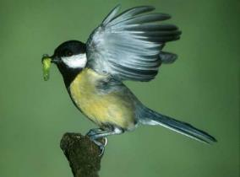
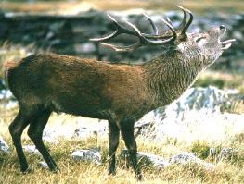
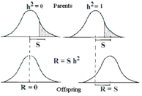
Components of variation and estimation of genetic effects
Alastair Wilson

Slide 2
Evolutionary quantitative genetics
Trait evolution = selection X genetic variation

Slide 3
Evolutionary quantitative genetics
Trait evolution = selection X genetic variation
Lots of genetic variation?
Selection on a trait will cause rapid evolution.
Relatives (share genes) and will have similar trait values.

Slide 4
Evolutionary quantitative genetics
Trait evolution = selection X genetic variation
No genetic variation?
Trait cannot evolve regardless of selection.
Relatives (on average) no more similar than pairs of unrelated individuals.

Slide 5
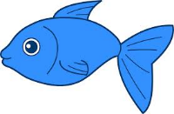





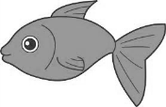





Phenotypic similarity among relatives tells us how much genetic variation there is.
Loads of genetic variation for size
Size is correlated within families, varies
a lot between families
Very little genetic variation for size
Size varies equally within- and between families

Slide 6
Partitioning phenotypic variance
For a phenotypic trait y, assume an individual’s phenotype is
y_{i} = μ + g_{i} + e_{i}
Then the population phenotypic variance (V_{P}) can be specified as
V_{P} = V_{G} + V_{E} + 2.COV_{G,E}
Assuming no covariance between genotypes and environmental effects
V_{P} = V_{G} + V_{E}

Slide 7
Quantitative genetics of continuous, polygenic traits with unknown genetic basis
additive
dominance
interaction
V_{G}
= V_{A} + V_{D} + V_{I}
genetic
+
V_{E}
environmental
phenotypic
V_{P}
A heritability estimate is specific to a population and an environment
Narrow sense heritability, or h²

Slide 8
Partitioning phenotypic variance
In the (assumed) absence of non-additive genetic effects:
y_{i} = μ + g_{i} + e_{i}
g_{i} is (ADDITIVE) GENETIC MERIT or BREEDING VALUE of individual i
Breeding value of i
Is the sum of the additive effects of its genes on trait y
Is twice the expected deviation of its offspring phenotype from the population mean (under random breeding).
Cannot be measured, but can be estimated or predicted

Slide 9
Partitioning phenotypic variance
In the (assumed) absence of non-additive effects:
y_{i} = μ + g_{i} + e_{i}
Partitions variance as:
V_{P} = V_{A} + V_{E}
Var(g_{i}) = additive genetic variance V_{A}
Narrow sense heritability as:
h² = V_{A}
V_{P}

Slide 10
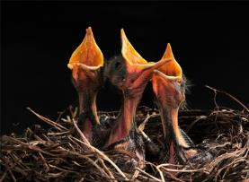
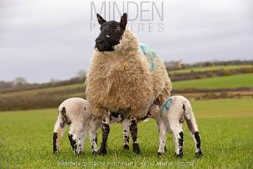
Partitioning phenotypic variance
Quantitative genetic methods assume an underlying model for the phenotype and, as a consequence, for the phenotypic variance.
Different partitions of V_{P} can be assumed (& compared statistically)
V_{P} = V_{A} + V_{E} + V_{nest}
V_{P} = V_{A} + V_{E}
V_{P} = V_{A} + V_{E} + V_{GxE}
V_{P} = V_{A} + V_{E} + V_{Mother}
Additional partitions can be interesting, but necessary to prevent bias in estimating V_{A} common environment effects are likely

Slide 11


Studying trait evolution
Will selection* cause a response?
How fast will it be?
What constrains adaptation?
What consequences does h² have ?
Why do we want to do this?
What’s the heritability?
Studying genetic architecture
Where are the genes?
What are the genes?
How many are there?
How do they act and interact?
Where does h² come from?
*Artificial or natural

Slide 12
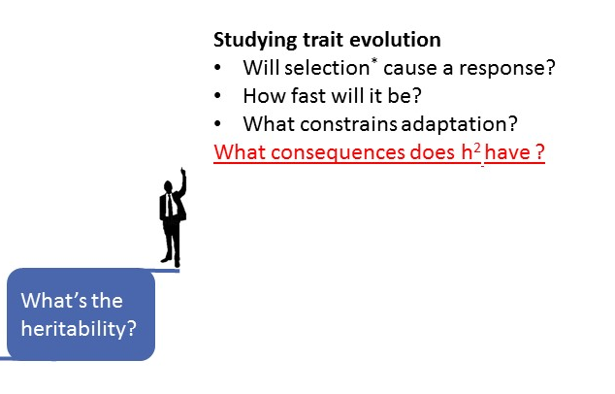
Trait evolution = genetic variation X selection
Univariate breeder’s equation is normally written
Response is the change in trait mean after 1 generation of directional selection and Selection differential is a measure of how strong selection is.
For any trait (y) S can be determined as either
S=y_{sel} - y_{all} (useful when imposing artificial selection)
S=cov(y,w) where w is fitness (useful when estimating natural selection)

Slide 13
A toy example….
S
1. Animals vary in size in a population
2. Selection for large size (S), bigger animals more likely to survive and become parents to the next generation.
Frequency
Size
Reproduction
3. Mean size in next generation somewhere in between mean of unselected and selected in previous.
Why?
Selected parents transmit their trait values to offspring, but not perfectly as h²<1.
R
Frequency
Size

Slide 14
So how do we estimate V_{A} and h²
Several statistical methods available
Most appropriate depends on data structure
All methods require
a) phenotypic measurements
b) pedigree information

Slide 15
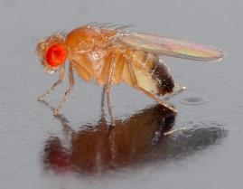
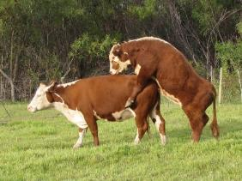
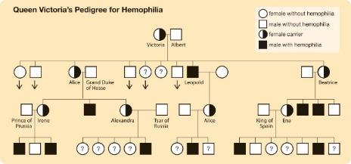
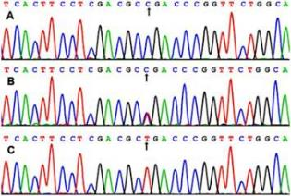
Pedigree (or relatedness) data from:
Experimental breeding design
Observation/record keeping
Historic records (human)
Molecular data (e.g. microsatellites, SNPs)

Slide 16
Pedigrees data and/or dense SNP genotypes increasingly available in wild populations

Slide 17
Statistical methods*
Parent-offspring regression
ANOVA-based analysis of sibling data
Linear mixed effect models
Sire-dam model
“Animal model” using pedigree (or marker-based relatedness)
*Can be used also to estimate genetic basis of covariation among traits which will be discussed later.

Slide 18
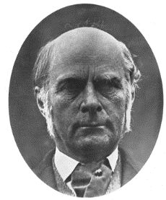
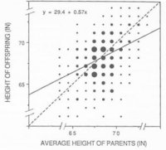
Parent-offspring regression
Francis Galton’s (1889) data showing the relationship between offspring height as a function of mean parent height
slope
The slope of the line (0.57) approximates the heritability of the trait when (within-family average) offspring values are regressed against the average of the two parents.

Slide 19
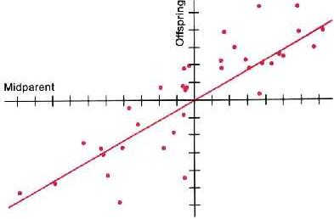
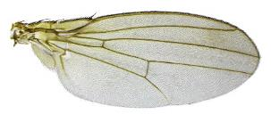
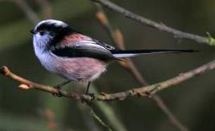
Parent offspring regression Regression of (mean) offspring phenotype on (midparent) phenotype
Winglength in Drosophila
(Reeve & Robertson 1953)
Feeding effort in Long tailed tits,
MacColl & Hatchwell 2003, Evolution
Midparent value= 0.5(y_{mother}+ y_{father})
h² = 0.59
Note if only a single parent is used, h²= 2x Slope

Slide 20
Connecting variation to evolution
The ‘Breeders Equation’
R=h²S
offspring
no selection, mean of offspring = mean of parents
midparent
(mean of parents)

Slide 21
Connecting variation to evolution
The ‘Breeders Equation’
R=h²S
selection response in offspring (r)
offspring
selection differential in parents (s)
midparent
(mean of parents)

Slide 22
Connecting variation to evolution
The ‘Breeders Equation’
R=h²S
offspring
midparent
(mean of parents)

Slide 23
Consider a perfect (small) pedigree:
male
# males = 8
# father-son pairs = 3
female

Slide 24
…a more realistic pedigree:
?
?
# males = 6
# father-son pairs = 1
?
male unidentified

Slide 25
…an even more realistic pedigree:
?
?
# males = 5
# father-son pairs = 0
trait not measured
but lots of measured relatives…..

Slide 26
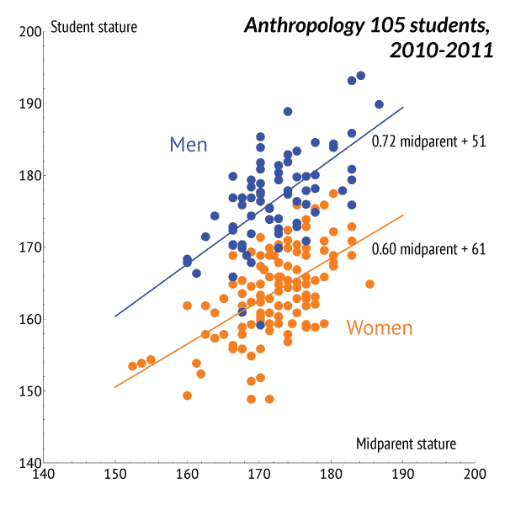
Parent offspring regression is rarely used now
Often inefficient use of existing data -> low precision
Maternal effects can drive mother-offspring covariance -> bias
Families may differ in size -> need for weighted regression?
Phenotypes from 2 generations needed (sometimes hard to obtain)
Still useful sometimes (e.g., exploratory/illustrative analyses)

Slide 27
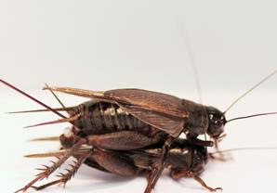
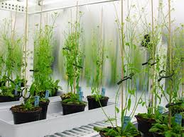
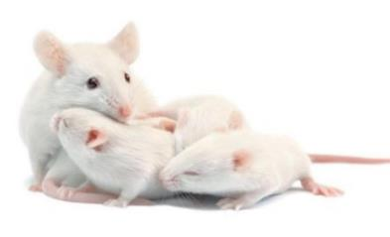
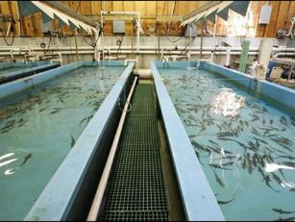
Sib analysis
Genes shared by siblings and half-sibs too
Use phenotypic similarity among sibs to estimate V_{A}
Set up crosses to make sibships
Traditionally parameters estimated using ANOVA
Sib analysis useful where breeding designs can be controlled

Slide 28
Sib analysis
Simple half-sib design.
A number of males, each crossed with several females to produce half-sib families. Measure phenotype (y) for one offspring/female
♀₁
y₁₁
♀₂
y₁₂
Half-sib family
♂₁
♀₃
y₁₃
♀₄
y₂₄
♂₂
♀₅
y₂₅
Half-sib family
♀₆
y₂₆

Slide 29
Sib analysis
Simple half-sib design.
A number of males, each crossed with several females to produce half-sib families. Measure phenotype (y) for one offspring/female
♀₁
y₁₁
One way ANOVA
♀₂
y₁₂
♂₁
 | E(MS)
Among family | V_{E} + n.V_{sire}
Within family | V_{E}
Total | V_{P}
♀₃
y₁₃
♀₄
y₂₄
♂₂
♀₅
y₂₅
Families of equal size (n)
♀₆
y₂₆
V_{sire} = 0.25(V_{A})

Slide 30
Sib analysis
Full-sib half-sib design.
More complex, but can be used to get at dominance variance V_{D} and/or maternal effects shared by full sibs but not paternal half sibs.
♀₁
y₁₁
y₁₁
y₁₁
♀₂
y₁₂
y₁₂
Full sibs nested within half sib family
♂₁
y₁₂
♀₃
y₁₃
y₁₃
y₁₃
♀₄
y₂₄
y₂₄
♂₂
y₂₄
♀₅
y₂₅
y₂₅
Full sibs nested within half sib family
y₂₅
♀₆
y₂₆
y₂₆
y₂₆

Slide 31
Sib analysis
Full-sib half-sib design.
More complex, but can be used to get at dominance variance V_{D}
♀₁
y₁₁
y₁₁
y₁₁
Nested ANOVA partitions variance into
-between sire
-between dam within sire
-within progenies
These used to calculate V_{A} and V_{D}
♀₂
y₁₂
y₁₂
♂₁
y₁₂
♀₃
y₁₃
y₁₃
y₁₃
♀₄
y₂₄
y₂₄
♂₂
y₂₄
♀₅
y₂₅
y₂₅
y₂₅
♀₆
y₂₆
y₂₆
y₂₆

Slide 32
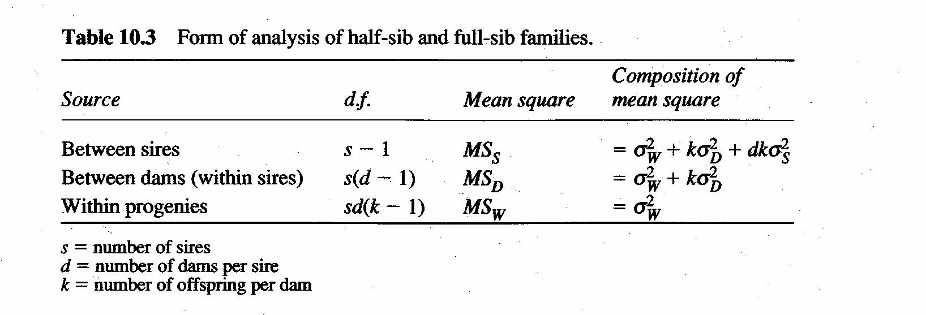
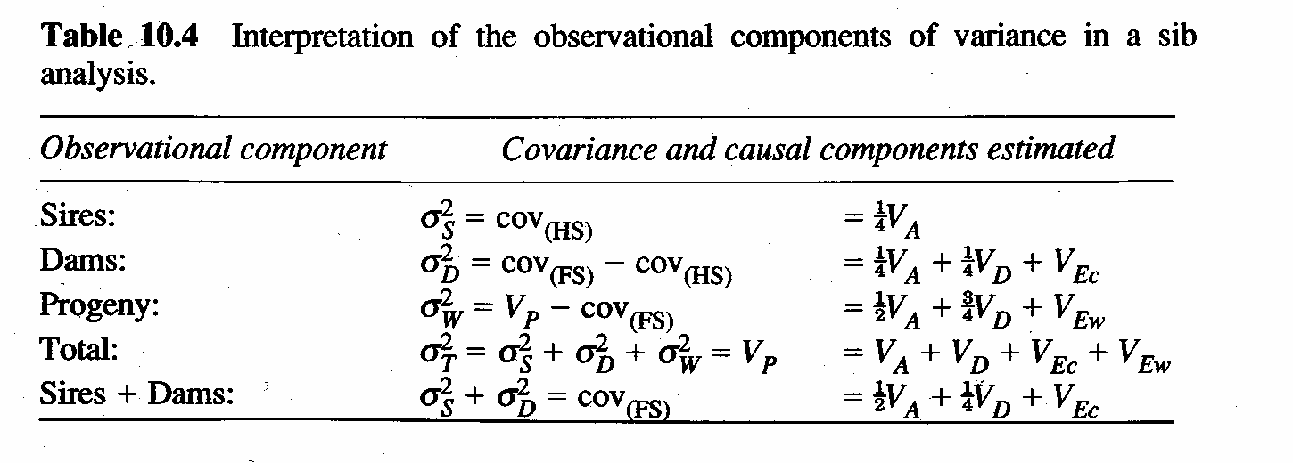
Falconer and MacKay 1998

Slide 33
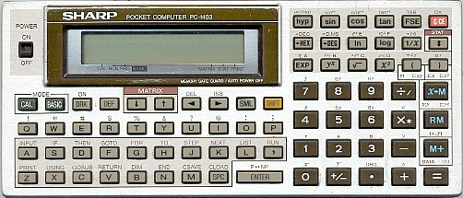


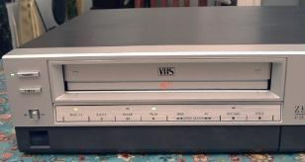
You can still use ANOVA to analyse breeding designs…
My calculator from 1985
+ It still works!
+ You can do ANOVA by hand
+ We teach ANOVA to undergrads
Other “cutting edge” 80s items
…but we have better tools now
Mixed effect models (REML or Bayesian)

Slide 34
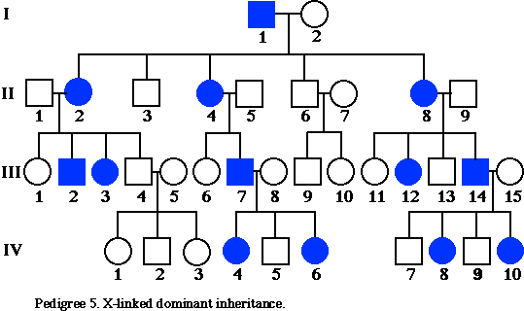
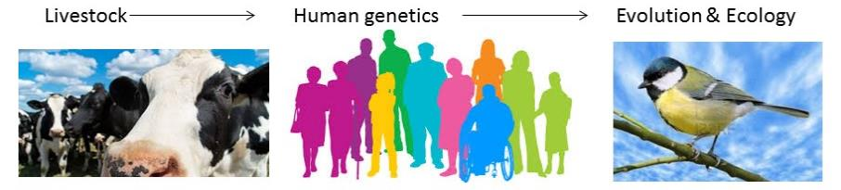
V_{A} estimation with mixed models
Don’t require balanced data sets, equal family sizes etc
Increased flexibility to model other effects (sex, age, common environment effects) simultaneously
Suited to experimental and non-experimental data
Likelihood (REML) or Bayesian parameterisation
Animal model efficiently uses data from any pedigree

Slide 35
Anatomy of a mixed model Contain fixed and random effects
Consider a simple linear model:
y_{i} = c + b x + e_{i}
c and b are FIXED EFFECTS estimated e.g by least squares regression. e_{I} is a residual - the difference between predicted and observed y_{i}
y
slope = b
Var (e_{i}) = residual variance
Assume residuals are independent across data points
c
ε_{i}
Sometimes data points can be grouped and may not be independent
x

Slide 36
Group fitted as a random effect - accounts for correlated "errors" among individuals.
y_{i} = c + b x + ε_{group} + ε_{residual.i}
1) Grouping variable could be identity, year of measurement, mother, nest etc
2) "Group effects" are assumed to have come from population with multiple factor levels, and distribution of mean 0 and variance V_{group}
3) Unexplained (by fixed effects) variance = V_{group} + V_{residual}
Random effects partition variance !

Slide 37
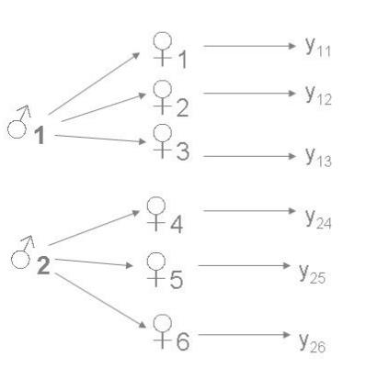
Family as a random effect
Given a set of full-sib families
Sire (or dam) identifies the family group
y = μ + sire + e
sire as a random effect assumed ~N(0,V_{sire})
V_{P} = V_{sire} + V_{e}
Where V_{sire} = 0.5(V_{A})
For half-sib families V_{sire}=0.25(V_{A})

Slide 38
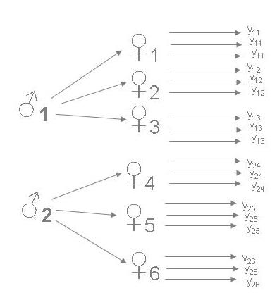
Family as a random effect
Full-sib nested within half sib-families
Fit sire and dam as random effects
y = μ + sire + dam + e
V_{P} = V_{sire} + V_{dam} + V_{e}
Where V_{sire} = 0.25(V_{A})

Slide 39
Mixed effect models partition variance!
y_{i} = μ + g_{i} + e_{i}
random residual error
phenotype of individual i
population mean
Random additive genetic effect, Breeding value
Fitting this model would give us estimates of
1) trait mean
2) V(a_{i}) which is V_{A} the additive genetic variance
3) V(e_{i}) or residual variance due to env effects (V_{R}).
4) V(y_{i}) or total phenotypic variance V_{P} as V_{A}+V_{R}

Slide 40

Mixed effect models partition variance!
y_{i} = μ + a_{i} + e_{i}
Random effects are grouping variables.
Mixed models require repeated observations within each factor level.
We don’t have this for a_{i} (unless working with a clonal organism).
Every individual has a unique genotype (ish..)

Slide 41

Mixed effect models partition variance!
y_{i} = μ + a_{i} + e_{i}
Mixed models require us to state how we expect random effects to contribute to covariance among observations.
Relatives share genes. Phenotypic covariance due to genes is predictable.
COV(a_{i}, a_{j})= 2 Θ_{ij} V_{A} where 2Θ_{ij} is relatedness
Pedigree lets us solve mixed model equations & estimate V_{A.}

Slide 42
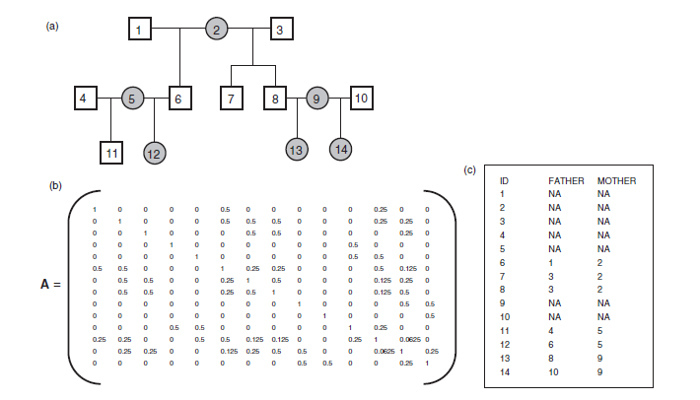
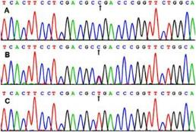
Pedigree defines A matrix. A⁻¹ is needed to solve for V_{A}

Slide 43
Sometimes there are non-genetic sources of variance we know about and want to remove.
y
Partition into V_{A} and V_{R}
μ

Slide 44
Fixed effects can be used to take out “noise” as well as test hypotheses.
Random effects to test hypothesis (e.g. is V_{A}>0?)
y
μ_{M}
Male
Female
μ_{F}

Slide 45
Include SEX as a fixed effect (2 level factor)
y_{i} = μ + SEX_{i} + a_{i} + ε_{i}
y
sex corrected mean
Partition into V_{A} and V_{R}
Male
Female

Slide 46

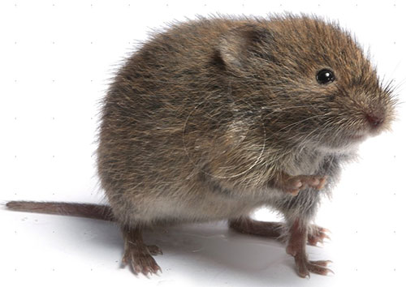


So let’s try some models!
Talk to each other… it will be more fun!
We’ll various R packages. Sadly not all the best things in life are free…

